Slide 1
On Computing Probabilistic Explanations
for Decision Trees
Marcelo Arenas, Pablo Barceló, Miguel Romero, Bernardo Subercaseaux
Presented by: Mateusz Błajda, Maciej Nadolski

Slide 2
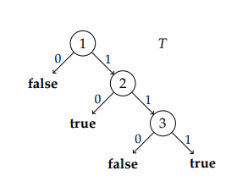
Background
Model
A decision tree
Binary features and classification
Sufficient reason
a form of local explanation
a set of features which are sufficient for a particular classification
x = (1, 1, 1); M(x) = true
Sufficient reasons:
y = {1, 2, 3}
y = {1, 3}

Slide 3
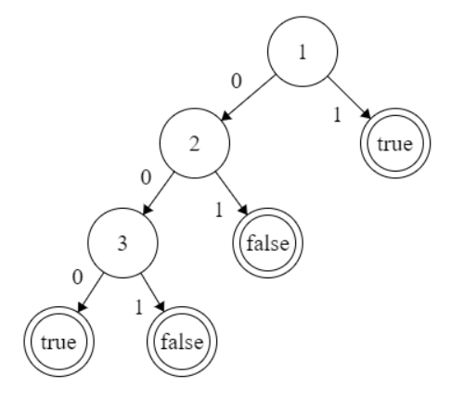
Minimal/minimum sufficient reason
sufficient reason is minimal if it’s minimal under subset partial ordering
requiring y to be subset minimal
sufficient reason is minimum if it’s minimal under reason size ordering
requiring |y| to be minimal
x = (1, 0, 0); M(x) = true
Minimal reasons:
y = {1}; y = {2, 3}
Minimum reason:
y = {1}

Slide 4
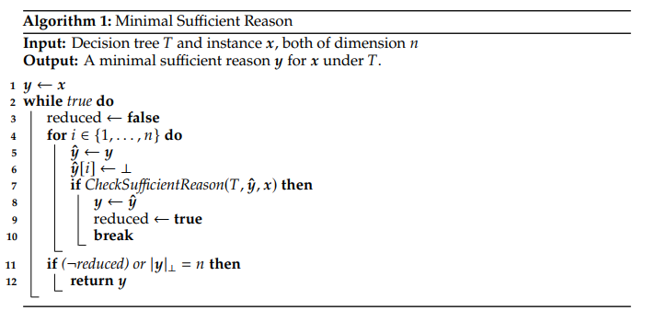
Minimal sufficient reason algorithm
A fairly straightforward polynomial time algorithm:

Slide 5
Minimum sufficient reason algorithm
can’t be computed in polynomial time (assuming P != NP)
proof in previous work (2020)

Slide 6
δ-sufficient reasons
treat all unspecified features as random with uniform distribution
y is a δ-sufficient reason for x if
P(M(x) = M(Y)) > δ
Y is an instance that is equal to x on features in y, uniformly distributed otherwise
we define minimal/minimum δ-sufficient reasons analogously
finding both is an NP-hard problem

Slide 7
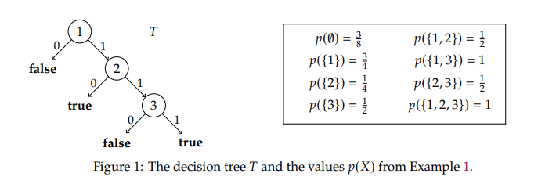
δ-sufficient reasons

Slide 8
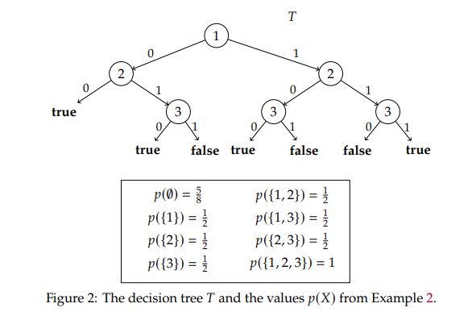
δ-sufficient reasons

Slide 9
Time complexity of δ-sufficient reasons
We consider the problem of computing minimum/minimal δ-SR for a fixed δ∈(0,1]
Assuming that PTIME ≠ NP
There is no polynomial-time algorithm for δ-Compute-Minimum-SR.
There is no polynomial-time algorithm for δ-Compute-Minimal-SR.
(Proofs in a paper)
For δ = 1 there exists a polynomial algorithm, based on observation 1. For δ ≠ 1 observation is no longer valid.
See example 2:
y_{{1,2,3}}is ⅝-SR but is not minimal, because y∅ is also ⅝-SR. But if we remove any feature from y_{{1,2,3}} we don’t get ⅝-SR.
So, we cannot use similar algorithm.

Slide 10
Trackable Cases
We can find polynomial algorithms for both minimum and minimal δ-SR if we apply some restrictions:
Bounded split number
Monotonicity

Slide 11
Bounded split number
T - decision tree
U - set of nodes
N_{u}↓- set of nodes in a subtree rooted in u
N_{u}↑- all the other nodes
F(U) - set of features in nodes U
Split number =
max _{node u in T} |F(N_{u}↓)∩ F(N_{u}↑)|
The measure of interaction (number of common features) between the subtrees of the form T_{u} and their exterior

Slide 12
Bounded split number
Let c ≥ 1 be a fixed integer. Both Compute-Minimum-SR and Compute-Minimal-SR
can be solved in polynomial time for decision trees with split number at most c
Proof in the paper

Slide 13
Monotonicity
Lets define an order:
x≼y iff x[i] ≤ y[i], for all i ∈ {1, . . . , n}
Model M is monotone if:
x≼y ⇒ M(x) ≤ M(y).
So basically if M(x) = 1 than if we replace any 0 in x with 1 and get x’: M(x’) = 1
For monotone models we can find both minimal and minimum δ-sufficient reasons in polynomial time
Again, proof in a paper

Slide 14
SAT to the Rescue!
We can encode minimal/minimum δ-sufficient reasons problem as CNF satisfiability (SAT) problem. (like any NP problem)
We can then use SAT Solvers to solve it.
Such encryptions are described in the paper.

Slide 15
Thank you for your attention

